Slide 1

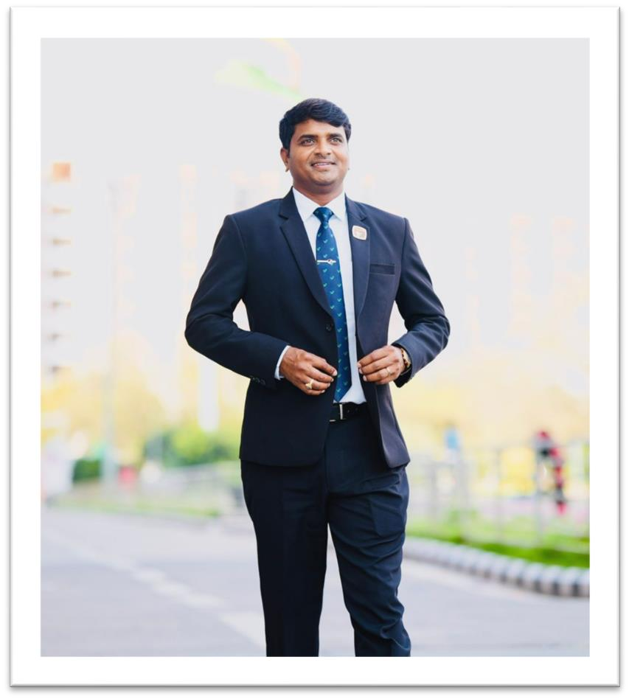



MY SUCCESS SECERET

Slide 2










DREAM BIG
Dream Car
Dream House
Dream Foreign Trip
Dream For Buying Gold
Dream For Buying Properties
PEOPLE SHOULD LAUGHT ON YOUR
DREAM CHART
DREAM + VISUALISATION = SUCCESS

Slide 3

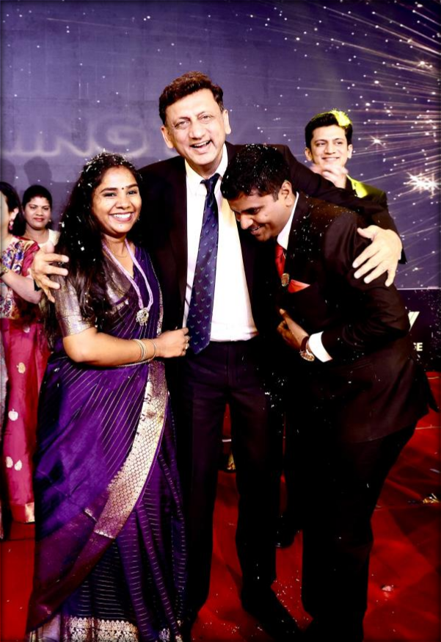
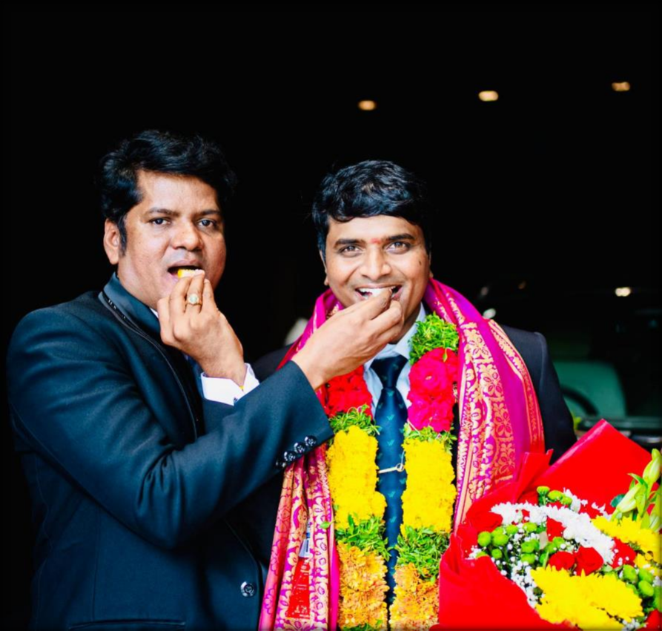





CHOOSE A RIGHT MENTORSHIP
MY MENTORS
They Guide Right Way To Success in Vestige & Life Also.
SP BHARIL SIR
PURUSHOTTAMADASU SIR

Slide 4

ACTION PART
IAM CORE GAME IS OVER.
160 PV
Plan Your Day.
Prospecting to people at (Tea Stalls, Temple, Tiffin Centers, On Road, Bus ETC).
Team Calling in Every Day.
Identify Your Active Growing Leaders & Work with them.

Slide 5
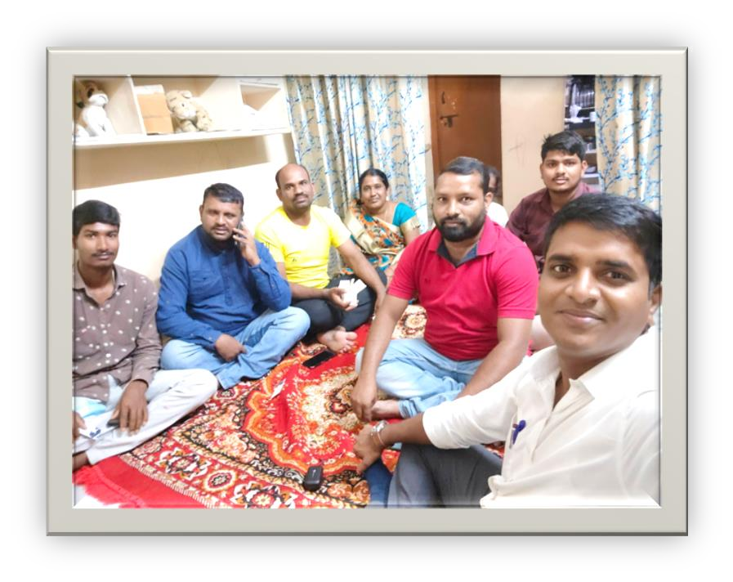
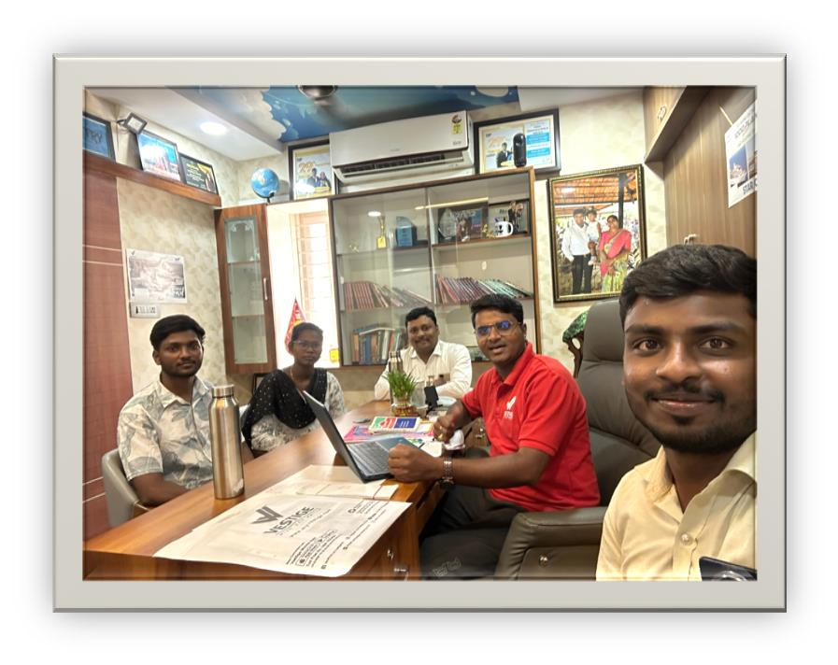
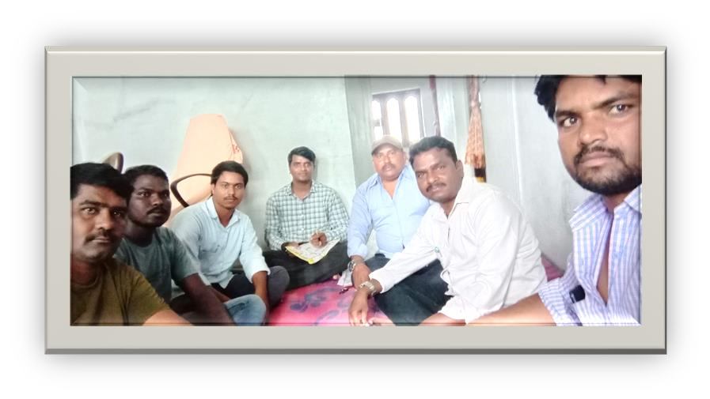
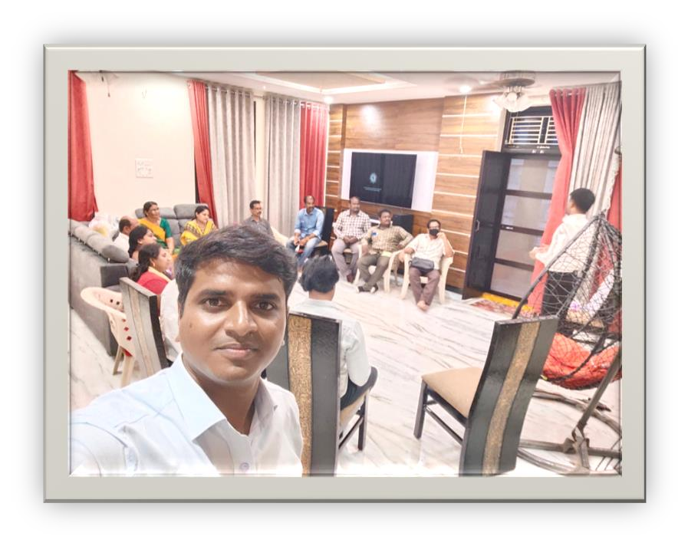
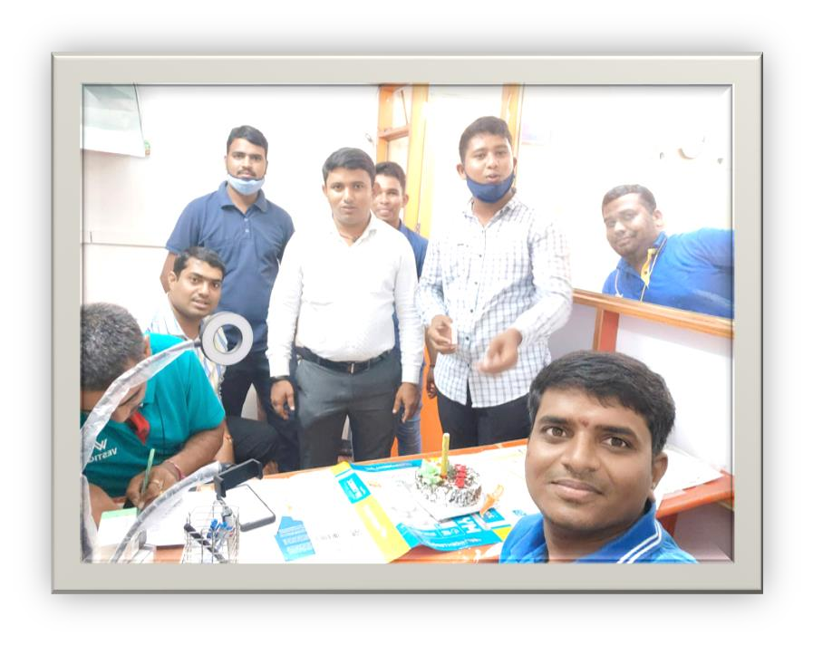
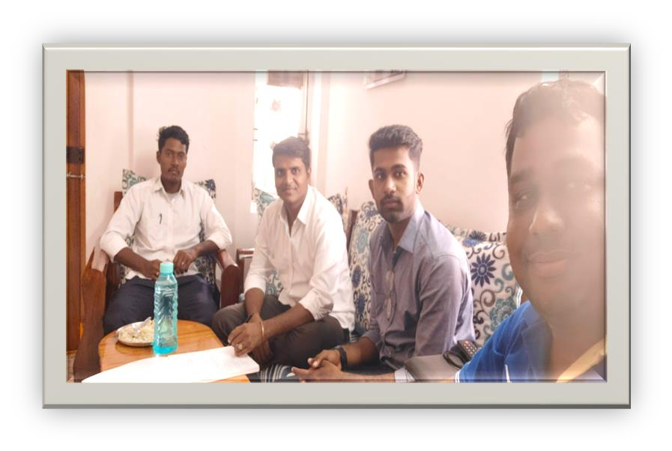
MY HOME MEETINGS

Slide 6
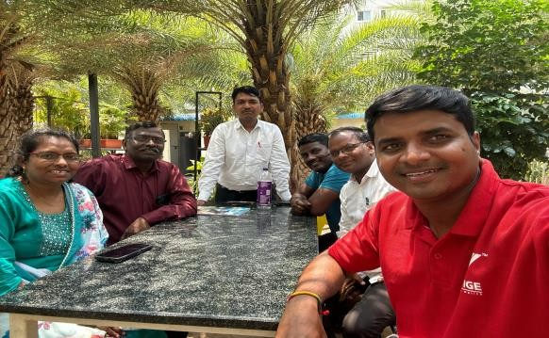
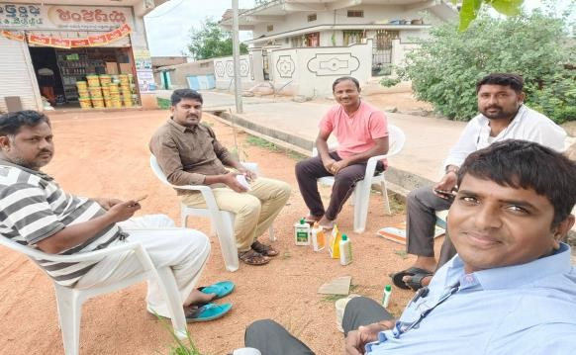
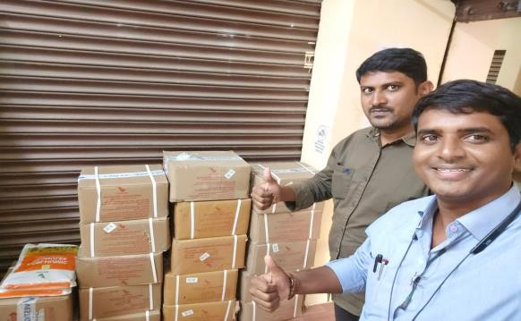
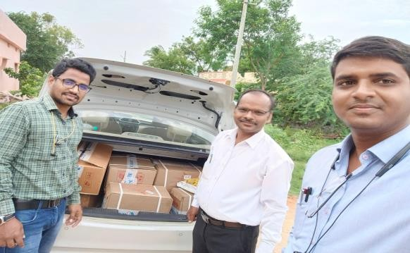
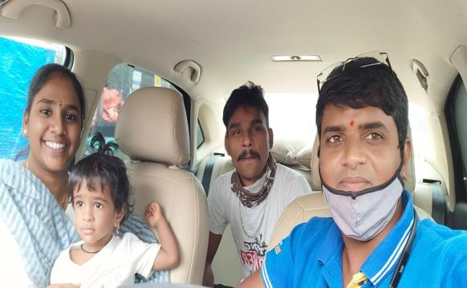
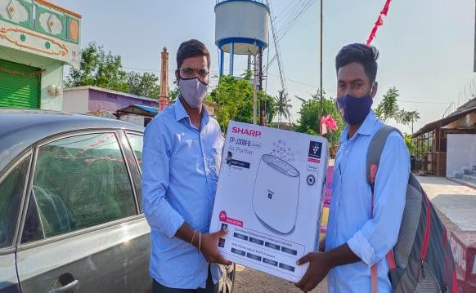
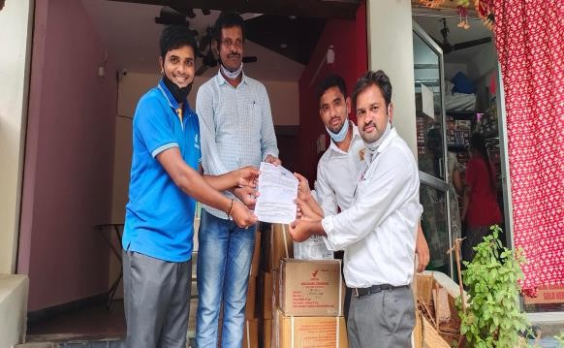
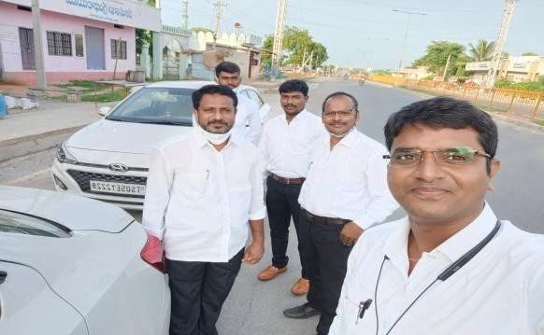
EVERY DAY MY FIELD WORK

Slide 7
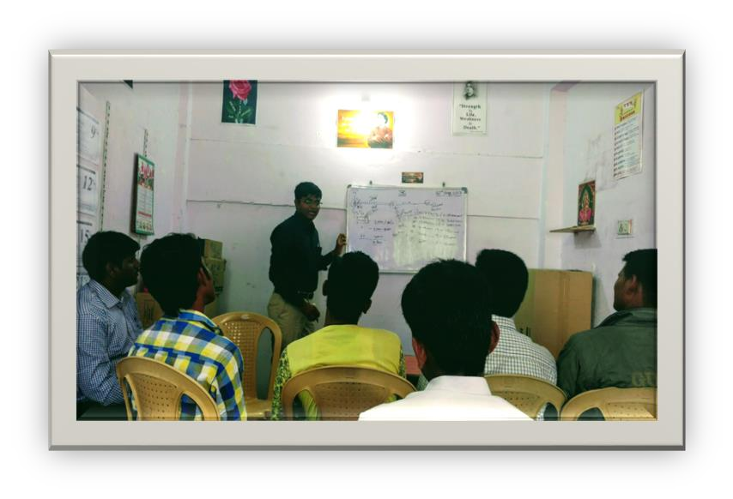
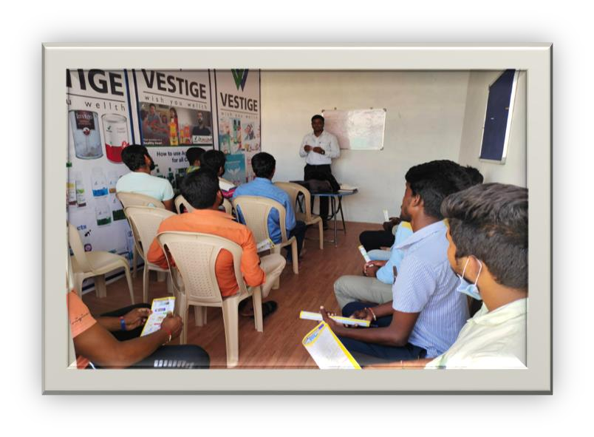
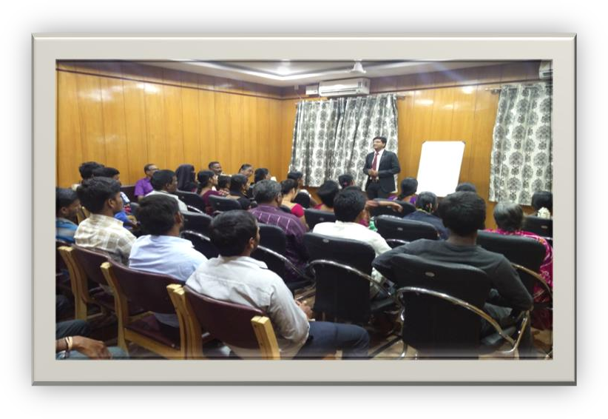
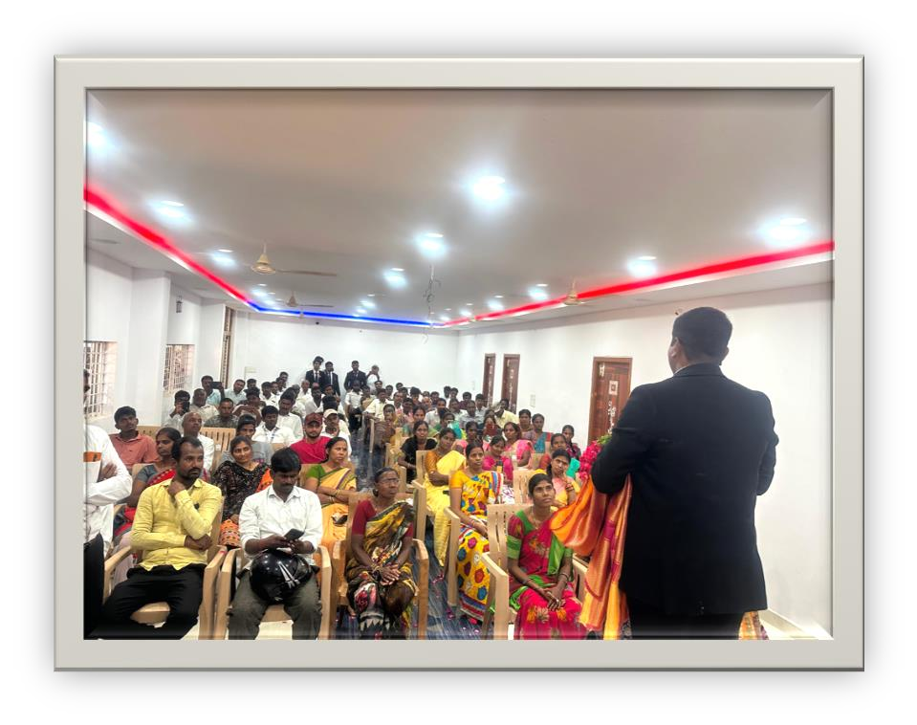
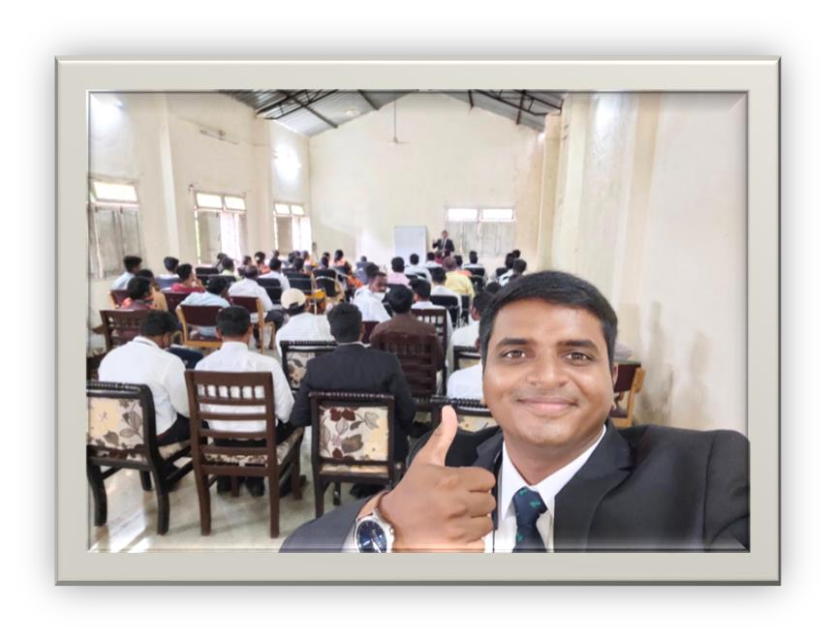
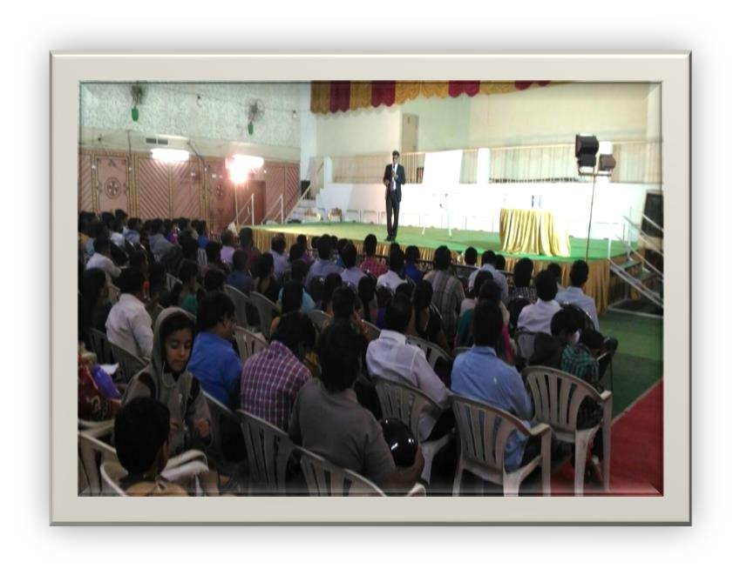
MY PHASE MEETINGS

Slide 8
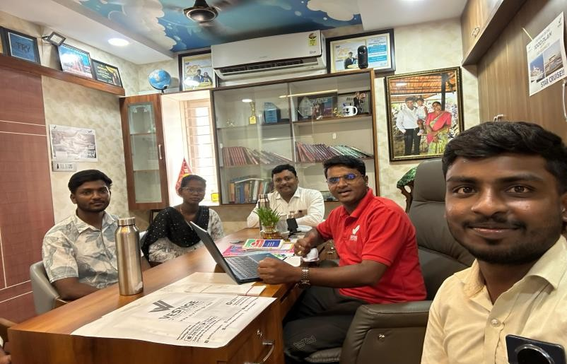
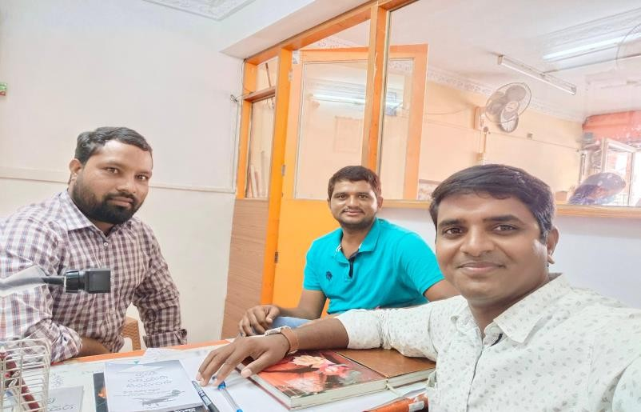
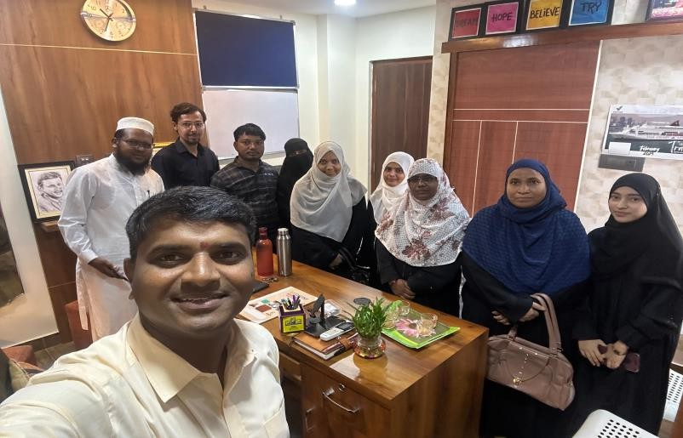
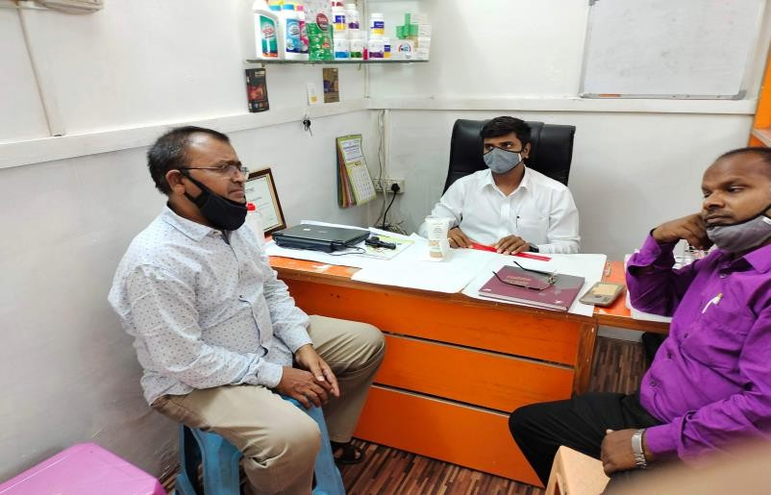
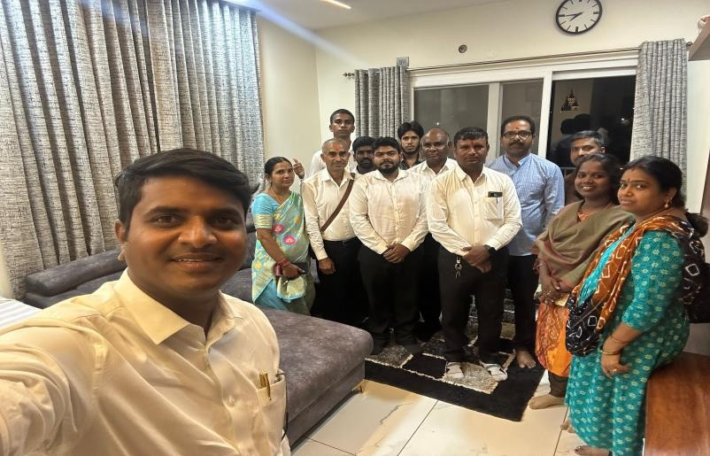
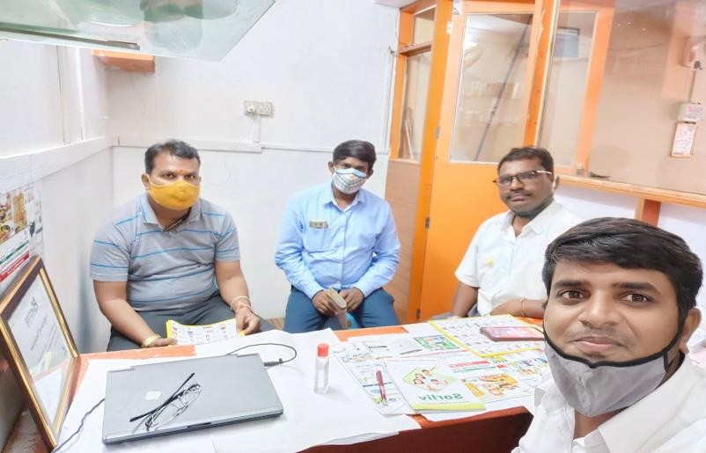
MY TEAM COUNSELINGS

Slide 9
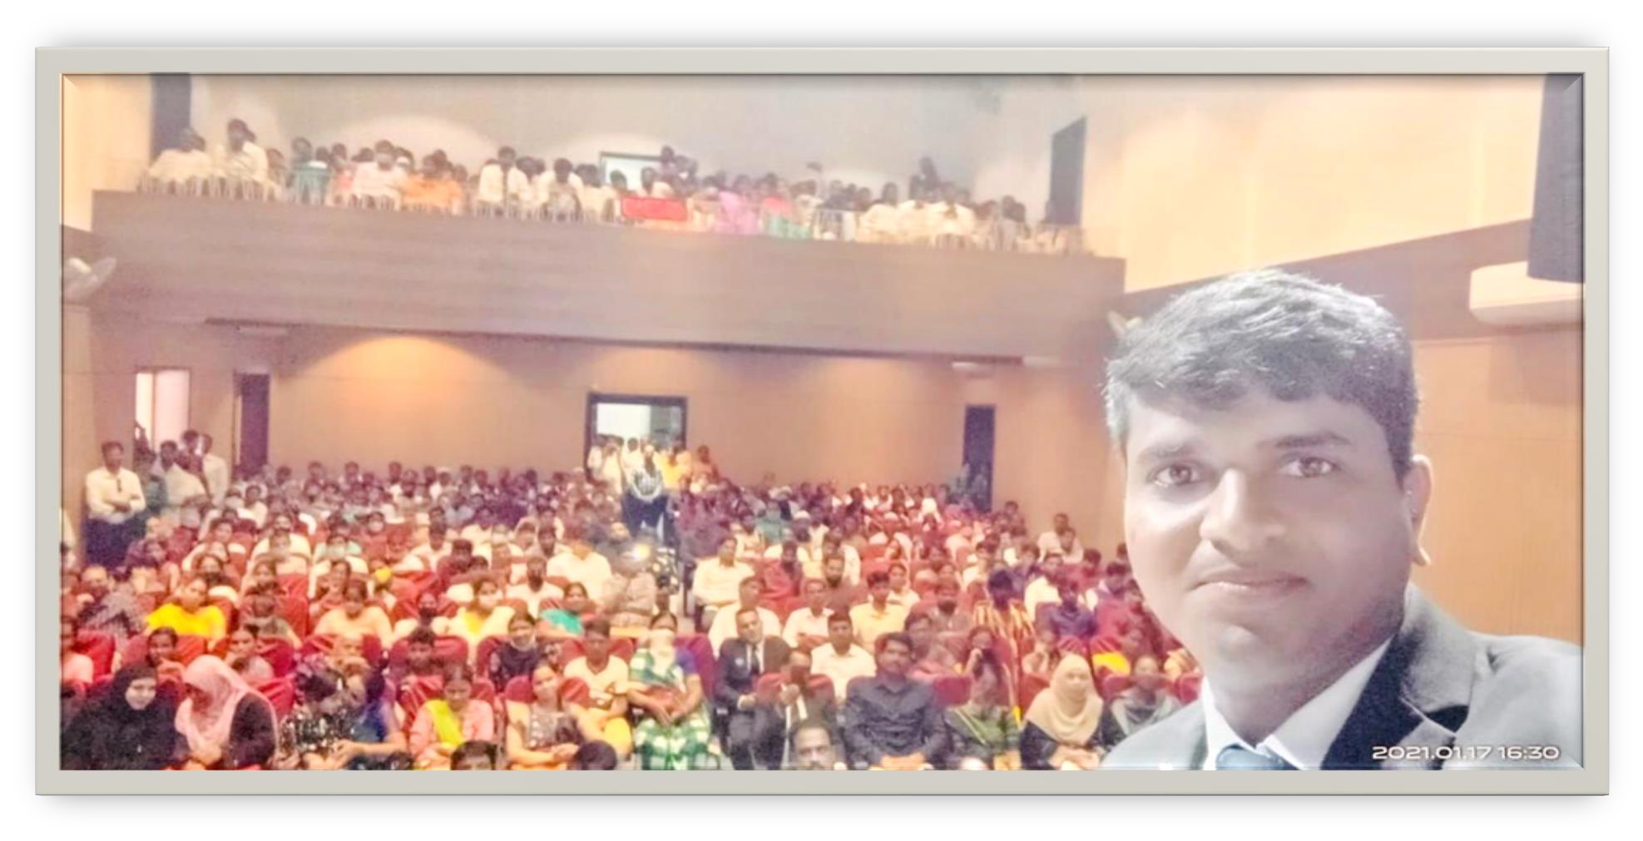




MUST AND SHOULD EVERY WEEK ATTEND THE OPEN MEETINGS
BECAUSE SMALL MEETING SMALL DECISION BIG MEETING BIG DECISION

Slide 10
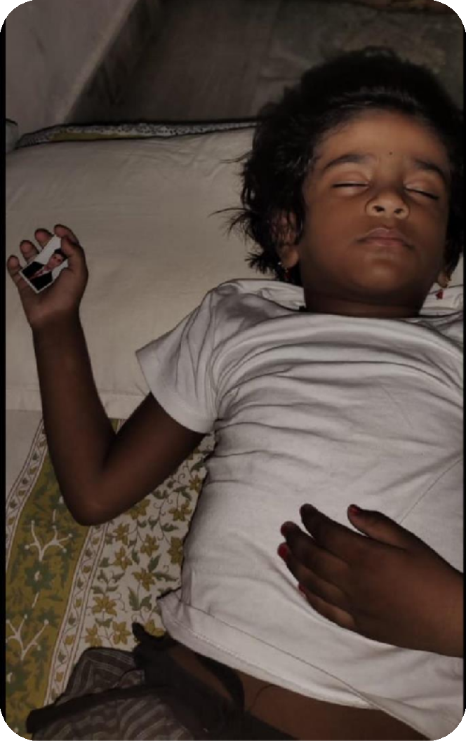
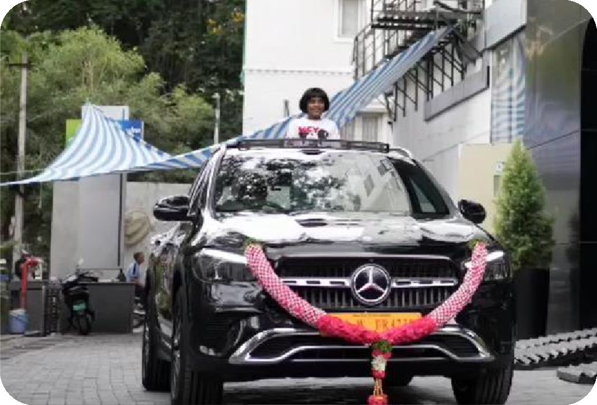


MY PAIN FULL DREAM

Slide 11




గుర్తు పెట్టుకో... నువ్వు జీవితంలో ఎంత ఎక్కువగా కాలుతావో .. నీ విలువ అంత పెర్తగు ంది..
RS: 10 /-
RS: 20 /-
RS: 100 /-

Slide 12




RIGHT WAY TO USE SOCIAL MEDIA
CREATE A SOCIAL MEDIA ACCONTS (WhatsApp, Facebook,
Instagram, and YouTube)
Promote Business regularly in all social media groups
Work with Consistency and Promote our business plans in Social Media Consistency

Slide 13

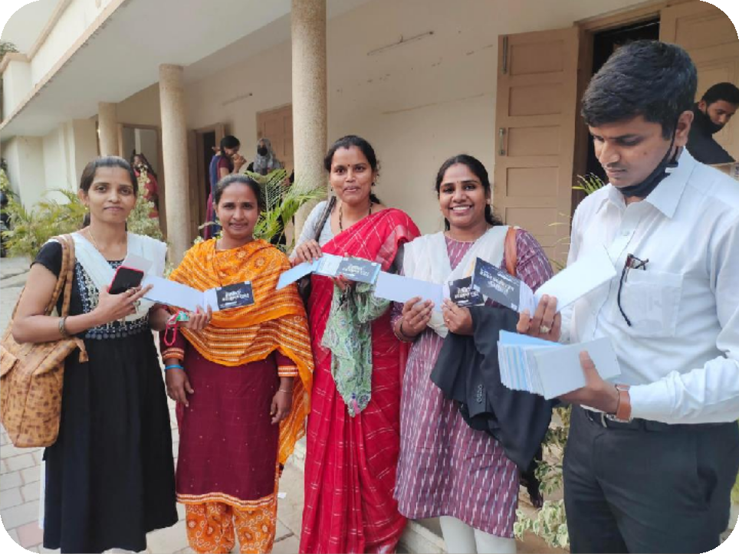

FOLLOW THE WINNING TEAM SYSTEM
Promote Winning Team Tools
Promote the CEP App
Promote Winning Team Life Changing Programs ( FRU FAMILY RE-UNION, GO CROWN Meetings )

Slide 14
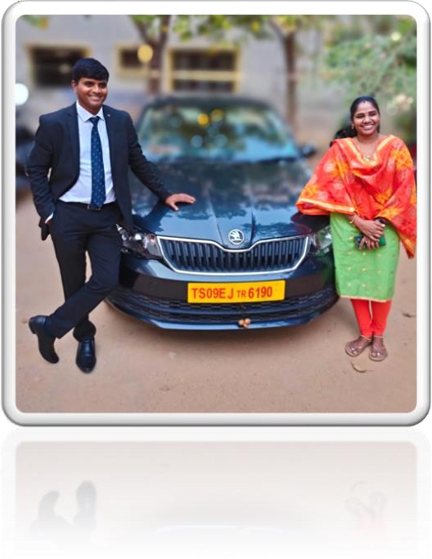
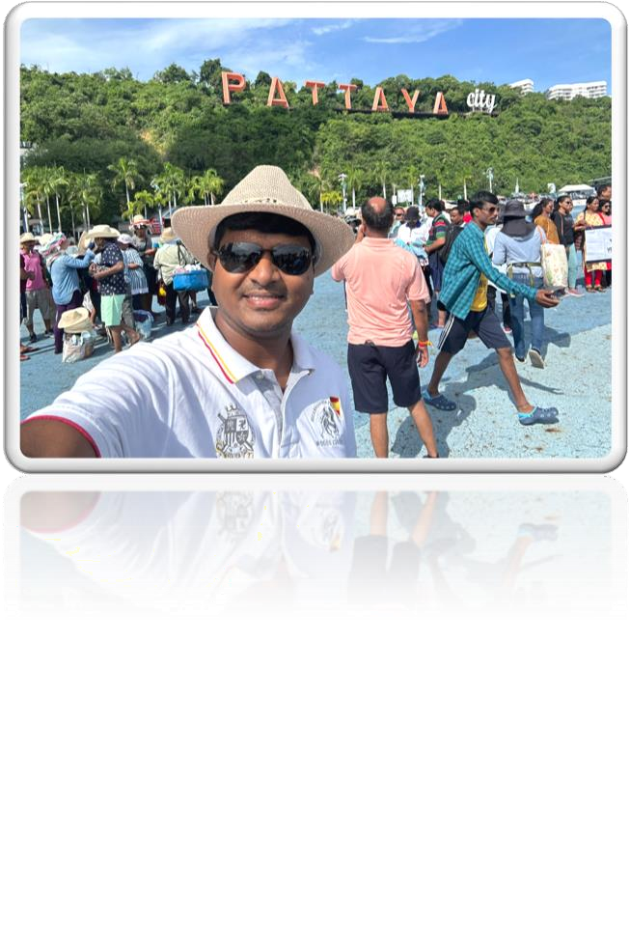

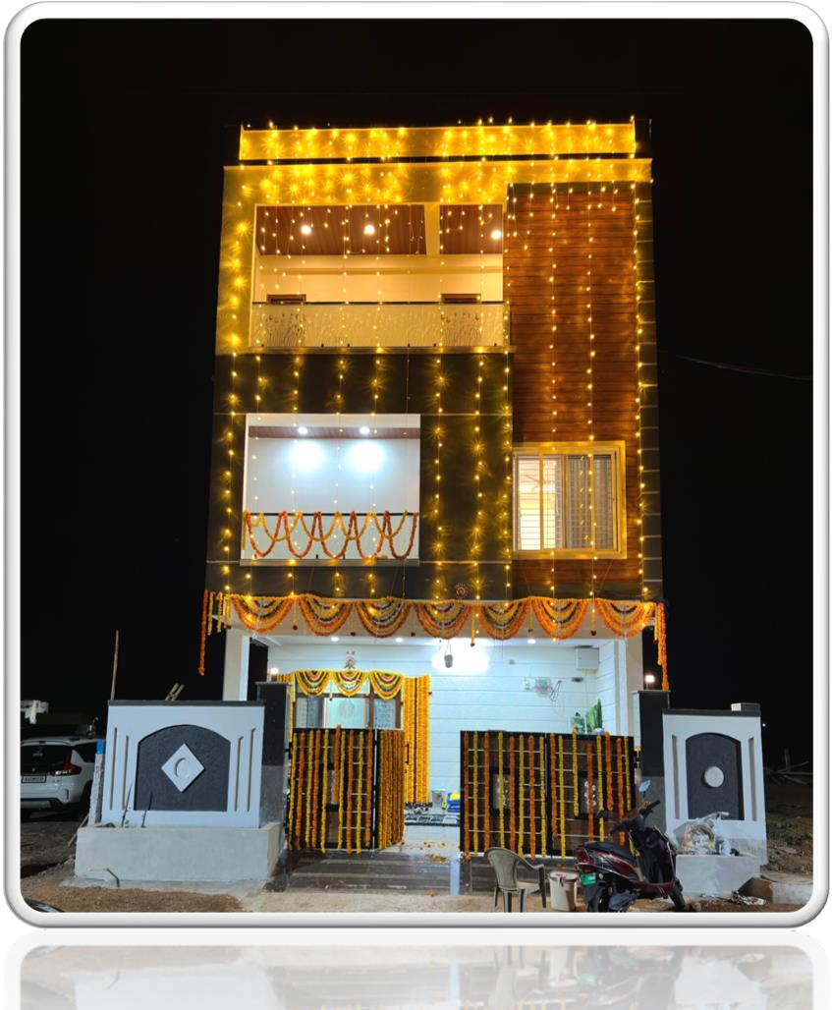
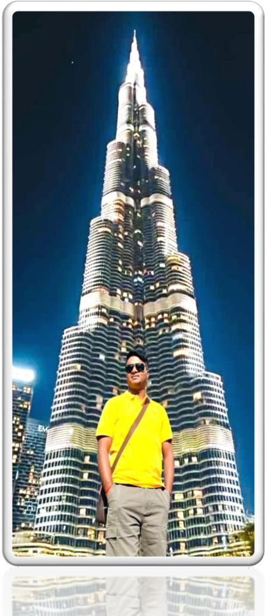
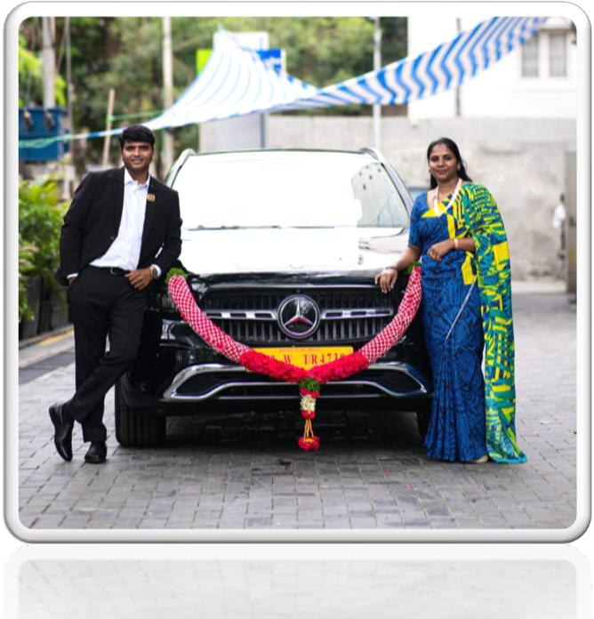
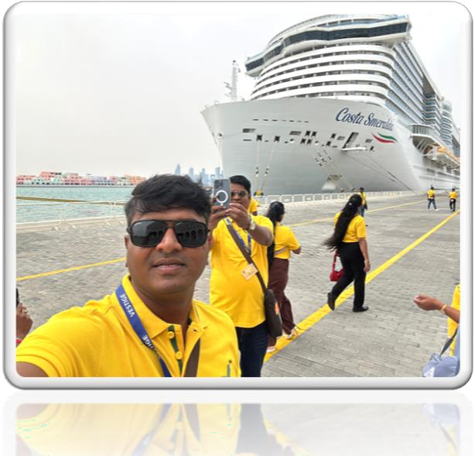
MY DREAMS FULLFILLED
FIRST MONTH INCOME : 164 /-
HIGHEST INCOME : 10,00,000 /-

Slide 15
SRINIVAS VADDEMANU (DUCD)

